Slide 1








Tracking Progress of the Mitigation Commitments of Nationally Determined Contributions (NDCs)
Presentation: Projections and Mitigation tracking
Dominic Sheldon
Ricardo Energy & Environment

Slide 2
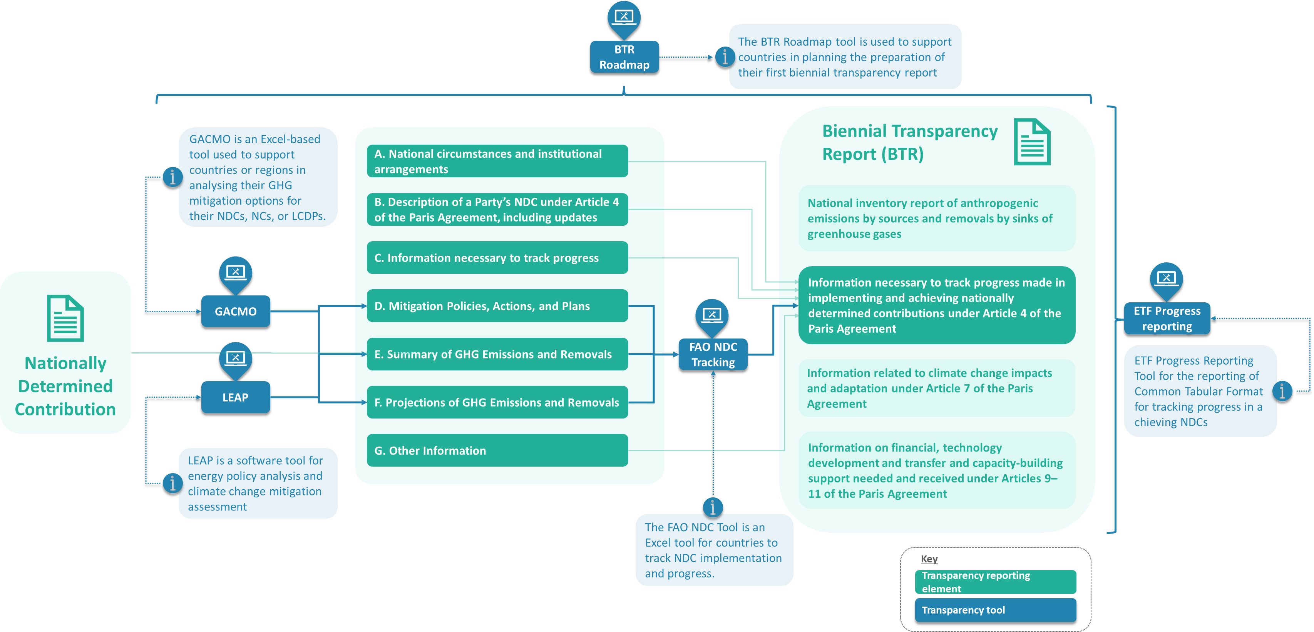

Slide 3

PATPA Publication on Projections
Contents
The importance of developing projections
Basic approach to developing GHG projections
Quality Assurance and Quality Control
Refining the projection´s approach over time
https://transparency-partnership.net/publications-tools/projections-greenhouse-gas-emissions-and-removals-introductory-guide

Slide 4
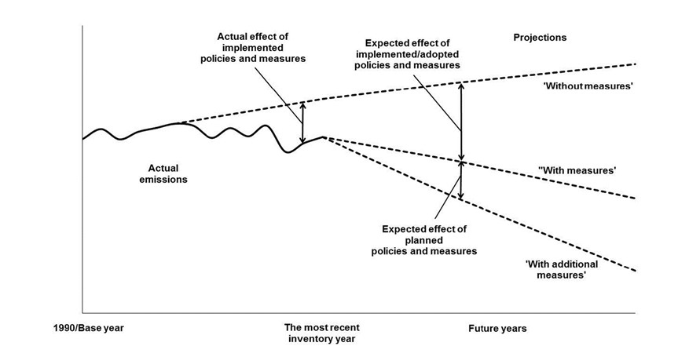
Projections

Slide 5
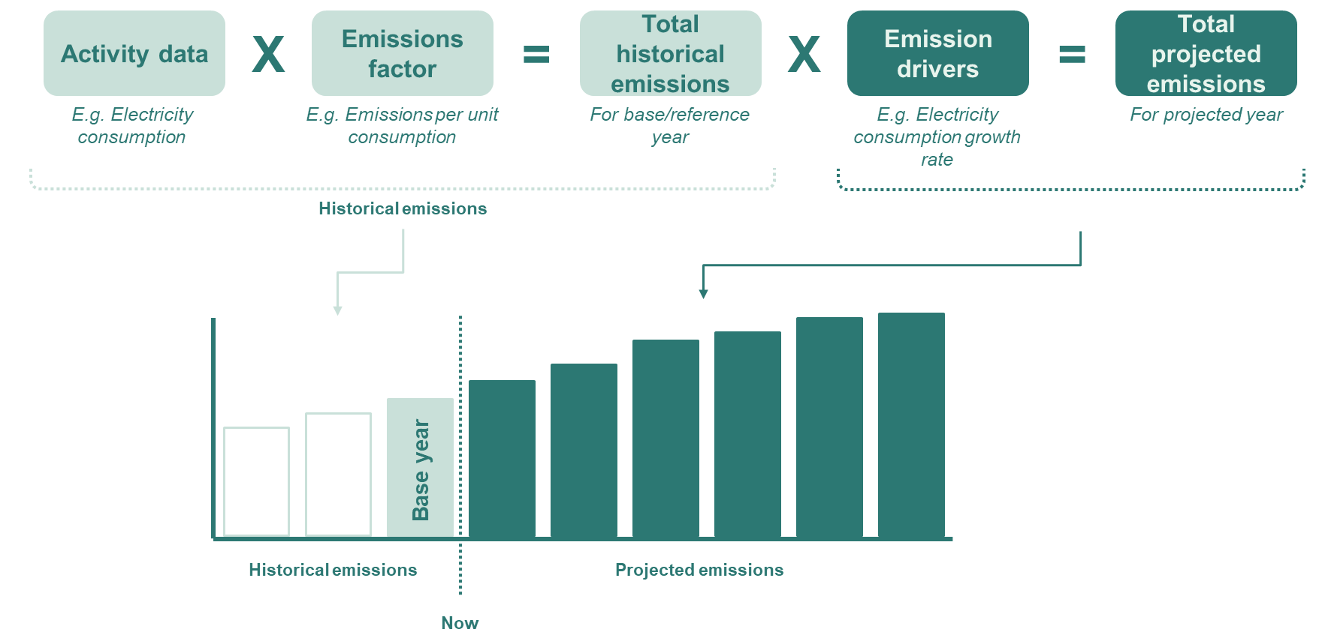

Slide 6
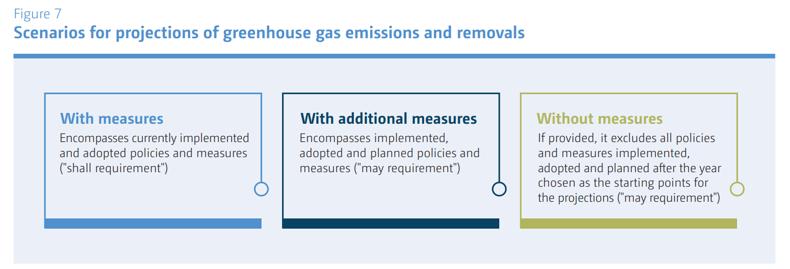
Scenarios for projections of greenhouse gas emissions and removals

Slide 7
Reporting projections: Scenario types
Scenario | Baseline scenario | Mitigation Scenario
‘Without measures’ (WOM) | If provided, it excludes all policies and measures implemented, adopted and planned after the year chosen as the starting points for the projections ("may requirement")
‘With existing measures’ (WEM) | Encompasses currently implemented and adopted policies and measures ("shall requirement") | means projections of anthropogenic GHG or air pollutant emissions by sources that encompass the effects of currently implemented or adopted policies and measures
‘With additional measures’ (WAM) |  | Encompasses implemented, adopted and planned policies and measures ("may requirement")
Source: EEA Projections in hindsight (2015)

Slide 8
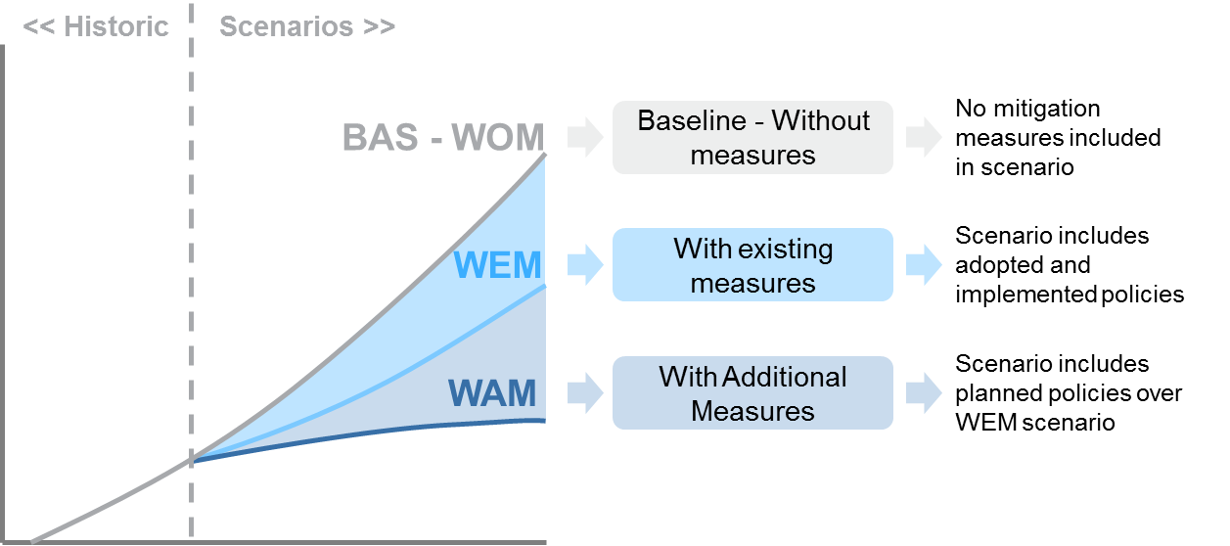

Slide 9
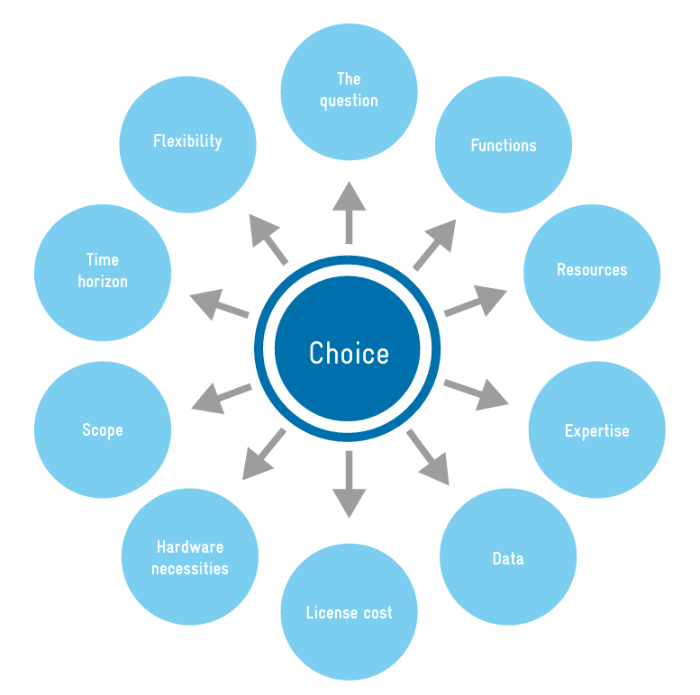
Developing projections
No standardised methodologies or tools exist to allow GHG projections to be calculated.
There are several modelling approaches/tools available which can help with this task.

Slide 10
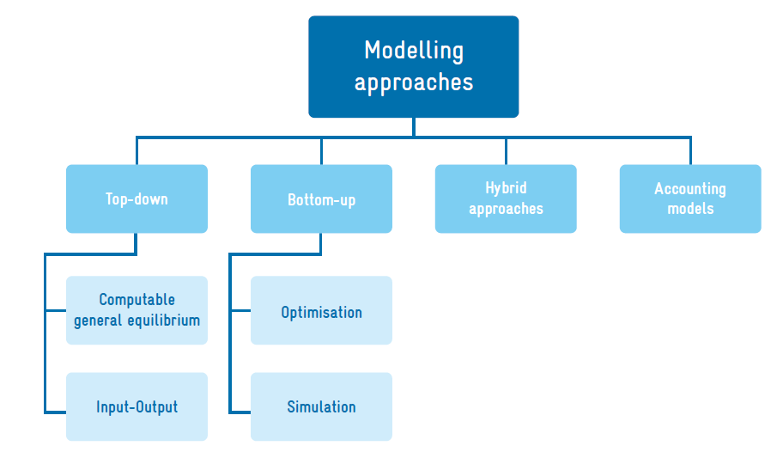
Developing projections

Slide 11
Model evaluation table
Evaluation Dimensions | General Equilibrium (CGE) Models | Input–Output (I/O) Models | Simulation Models | Optimisation Models | Accounting Models
Scope of Analysis | Macro-economic | Sectoral | Sector-specific | Energy Systems | Energy Systems
Temporal Perspective | Long-term (Multi-year) | Short to Medium-term (5-15 years) | Short to Medium-term | Long-term (40-50 years) | Flexible
Behavioural Realism | Moderate | Low | High | Moderate | Low
Technological Detail | Low | Low | High | High | Moderate
Ease of Use | Complex | Moderate | Moderate | Complex | Simple to Moderate
Cost Consideration | Yes | Partial | Yes | Comprehensive | Yes
Policy Impact Sensitivity | High | Moderate | High | High | Moderate
Flexibility | Low | Low | Moderate | Moderate | High
Examples | EPPA, ICES | IOTA, REMI | POLES, AERO | MARKAL/TIMES, MESSAGE | LEAP, GACMO

Slide 12
Choosing a model type
Question | Suggested Model Type | Example of Model Type to Use
Impacts and costs of planned mitigation actions? | • All model types (for impacts) and some model types for costs | E.g., Any listed model type
Effects of mitigation actions on economic development/job creation? | • Top-down macro-economic models | E.g., General Equilibrium Models
Most cost-effective pathway to achieve target? | • Optimisation models | E.g., TIMES
Forecast of future emissions? | • Accounting models | E.g., LEAP
Evolution of emissions in a specific sector? | • Bottom-up simulation models | E.g., POLES
 | • Sectoral accounting models | E.g., EX-ACT
Modeling a long-term target? | • Hybrid modelling tools | Hybrid Models
Quick assessment of mitigation actions with limited expertise/data? | • Simple accounting tools | E.g., GACMO
Using the same model over time with limited data/expertise? | • Accounting tools | E.g., PROSPECTS+

Slide 13
Developing projections
Inputs:
Historical Data
  Historical Drivers: Economic indicators (like GDP), demographic data, energy usage trends, and changes in land use.
  Historical Emissions: Activity data including energy and industrial activities, and respective emissions factors.
  Non-emissions Data: Additional environmental data (e.g., deforestation rates) and socio-economic data.
Projected Data
  Drivers: Predictions on economic growth, demographic changes, and energy price fluctuations.
  Policies: Forthcoming government policies and industry standards regarding emissions reductions.
Tracking Data
  Assumptions: Economic and technological predictions for the future.
  Definition of Indicators: Criteria to gauge progress, such as GHG emissions reduction and energy efficiency improvement.
Outputs:
GHG Results: Forecasts of total and sector-specific GHG emissions and trend analysis.
Non-GHG Results: Evaluations of other environmental impacts and socio-economic outcomes.
Policy Evaluation: Analysis of the potential impact of proposed policies on GHG emissions and suggestions for policy modifications or new strategies.

Slide 14
Developing projections
Type of Driver | Example | Ease of Collection
Economic Activity | GDP, Household disposable income, Sectoral economic growth rates | Medium
Population | Census data, Urbanization rate, Population growth rate | High
Energy and Commodity Prices | Prices of natural gas, Electricity prices, Fuel prices, Agricultural commodity prices | Medium
Weather | Heating degree days, Cooling degree days, Average rainfall patterns | High
Technological Costs | Costs of renewable energy technologies, Costs of energy-efficient appliances | Low
Structural Effects | Shifts from industry to service sector jobs, Urbanization trends, Land-use change patterns | Low
Consumer Preferences | Preferences for vehicle types, Household energy use patterns, Preferences for public transport | Low
Autonomous Technological Improvement | Adoption rate of renewable energy sources, Energy efficiency improvements in industries | Low
Data requirements:
Historical data
Historical drivers
Historical emissions (activity data*emissions factors=emissions)
Non-emissions data (activity data)
Projected data
Projected data (drivers, policies)
Tracking data
Assumptions
Definition of Indicators
Outputs:
GHG results
Non-GHG results
Policy evaluation

Slide 15
Reporting projections
The assessment of projections has only been reported by the developed countries as part of their National Communications/ Biennial Reports to the UNFCCC.
As indicated in the most recent UNFCCC reporting guidelines on national communications for Parties included in Annex I to the UNFCCC (Decision 6/CP25 of 2019), "the primary objective of the projections section of the national communication is to give an indication of future trends in GHG emissions and removals, given current national circumstances and implemented and adopted policies and measures, and to give an indication of the path of emissions and removals without such policies and measures."

Slide 16
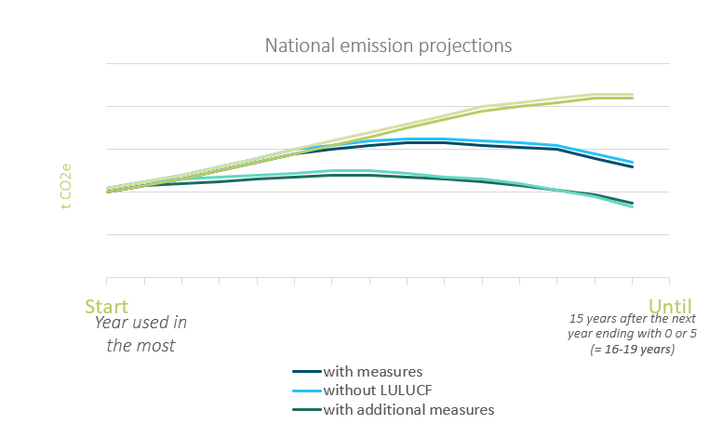
Reporting projections under the ETF
Under the Paris Agreement’s ETF all countries are required to report on GHG emissions projections.
Parties that need flexibility in light of their capacities are only encouraged to do so and if they decide to report GHG projections, they are provided further flexibility, e.g., with regards to the methodology used and how far they project into the future.
Whilst having the option not to report GHG projections can be helpful, countries should, nevertheless, carefully consider developing GHG projections as this information enables many decision-making processes. (PATPA, 2021)

Slide 17
Reporting projections under the ETF
Under the Paris Agreement’s ETF all countries are required to report on GHG emissions projections.
Specific reporting requirements for projections include:
Scenarios: to report a “with measures” scenario and can also provide a “with additional measures” and a “without measures” scenario (Tables 7,8,9)
Starting and ending years: The most recent year covered in the national GHG inventory report and extend at least 15 years beyond the next year ending in zero or five.
Scope by sector and gas: For the national total, by sector, by gas and with and without LULUCF.
A common metric consistent with the Party’s national GHG inventory report has to be used (e.g., Gg CO2-eq). (Table 10)
Projections must also be provided for key indicators (Table 11)
Methodologies and sensitivity analysis: Parties have to provide information on the methodology used to develop the projections

Slide 18
Reporting projections under the ETF
Para MPGs | Type | Requirement
92 | Shall / Encouraged | Report projections with flexibility for developing countries
93 | Shall | Indicative of the impact of PaMs, not for progress assessment unless specified
94 | Shall / May | Report 'with measures' projection and optionally others
95 | Shall | Projections to start from most recent year and extend at least 15 years, with flexibility for developing countries
96 | Should | Methodology description including models, changes, assumptions, and sensitivity analysis
97 | Shall | Provide projections of key indicators for NDC progress
98 | Shall | Include sectoral, by gas and national total projections using a consistent metric
99 | Shall | Present projections relative to actual inventory data
100 | Shall | Provide emission projections with and without LULUCF
101 | Shall | Present projections in graphical and tabular formats

Slide 19
Reporting projections under the ETF
Para MPGs | Type | Requirement
92 | Shall / Encouraged | Each Party shall report projections pursuant to paragraphs 93–101 below
93 | Shall | Projections are indicative of the impact of mitigation policies and measures on future trends in GHG emissions and removals, and shall not be used to assess progress towards the implementation and achievement of a Party’s NDC
94 | Shall / May | Each Party that reports pursuant to paragraph 92 above shall report a ‘with measures’ projection of all GHG emissions and removals and may report a ‘with additional measures’ projection and a ‘without measures’ projection.
95 | Shall | Projections shall begin from the most recent year in the Party’s national inventory report and extend at least 15 years beyond the next year ending in zero or five;
96 | Should | Each Party should provide information in describing the methodology used to develop the projections. This information should include: Models and/or approaches used and key underlying assumptions and parameters used for projections (e.g. gross domestic product growth rate/level, population growth rate/level); Changes in the methodology since the Party’s most recent biennial transparency report; Assumptions on policies and measures included in the ‘with measures’ projections and ‘with additional measures’ projections, if included; Sensitivity analysis for any of the projections, together with a brief explanation of the methodologies and parameters used.

Slide 20
Reporting projections under the ETF
Para MPGs | Type | Requirement
97 | Shall | Each Party shall also provide projections of key indicators to determine progress towards its NDC under Article 4 of the Paris Agreement.
98 | Shall | Each Party shall include projections on a sectoral basis and by gas, as well as for the national total, using a common metric consistent with that in its national inventory report.
99 | Shall | Projections shall be presented relative to actual inventory data for the preceding years.
100 | Shall | Emission projections shall be provided with and without LULUCF.
101 | Shall | Projections shall be presented in graphical and tabular formats.

Slide 21
Flexibility provisions available for developing countries for projections
REFERENCE IN THE MPGS (ANNEX TO DECISION 18/CMA.1) | PROVISION IN THE MPGS | FLEXIBILITY PROVISION FOR THOSE DEVELOPING COUNTRY PARTIES THAT NEED IT IN THE LIGHT OF THEIR CAPACITIES
Paragraph 92 GHG emission and removals projections | Each Party shall report projections | Those Parties that need flexibility are instead encouraged to report these projections.
Paragraph 95 Projections extension | Projections shall begin from the most recent year in the Party’s national inventory report and extend at least 15 years beyond the next year ending in zero or five | Those Parties that need flexibility have the flexibility to instead extend their projections at least to the end point of their NDC under Article 4 of the Paris Agreement.
Paragraph 102 Projections methodology or coverage | See paragraphs 93 through 101 of the annex to decision 18/CMA.1 | Those Parties that need flexibility can instead report using a less detailed methodology or coverage.

Slide 22
Reporting projections under the ETF
“102. Those developing country Parties that need flexibility in the light of their capacities with respect to paragraphs 93–101 above can instead report using a less detailed methodology or coverage.”
less detailed methodology or coverage.”

Slide 23
Reporting projections under the ETF
Para MPGs | Type | Requirement | FX
92 | Shall / Encouraged | Report projections with flexibility for developing countries | FX
93 | Shall | Indicative projections, not for progress assessment unless specified | FX
94 | Shall / May | Report 'with measures' projection and optionally others | FX
95 | Shall | Projections to start from recent year and extend at least 15 years, with flexibility for developing countries | FX
96 | Should | Methodology description including models, changes, assumptions, and sensitivity analysis | FX
97 | Shall | Provide projections of key indicators for NDC progress | FX
98 | Shall | Include sectoral, by gas and national total projections using a consistent metric | FX
99 | Shall | Present projections relative to actual inventory data | FX
100 | Shall | Provide emission projections with and without LULUCF | FX
101 | Shall | Present projections in graphical and tabular formats | FX

Slide 24
Thank you!
Dominic Sheldon – Dominic.Sheldon@Ricardo.com
Ricardo

