Slide 1





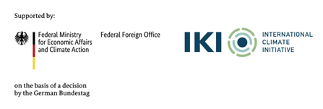


Introduction and Explanation of CTF Tables and Exercise:
Filling CTF Tables 1 and 2: Description and Definitions to understand NDC
Tracking Progress of the Mitigation Commitments of Nationally Determined Contributions (NDCs)
11 September 2023
Seoul, Republic of Korea
Aiymgul Kerimray
Mitigation specialist
UNEP Copenhagen Climate Centre

Slide 2
CTF tables for the electronic reporting of the information necessary to track progress made in implementing and achieving NDCs
NDC definition and methods
Appendix: Description of a Party´s NDC
Current mitigation status and tracking progress
Table 4: Tracking progress
Projections and expected emissions reduction
Table 7: Projections “with measures” scenario
Table 1: Description of selected indicators
Table 2: Definitions needed to understand the NDC
Table 3: Methodologies and accounting approaches
Table 5: Mitigation policies, measures, actions and plans (Achieved)
Table 6: Inventory summary
Table 8: Projections “with additional measures” scenario
Table 9: Projections “without measure” scenario
Table 10: Projections of key indicators
Table 11: Key underlying assumptions and parameters of projections
Table 5: Mitigation policies, measures, actions and plans (expected)
Response measures
Table 12. Information necessary to track progress on the implementation and achievement of the domestic policies and measures implemented to address the social and economic consequences of response measures

Slide 3
CTF tables: NDC indicators
Appendix
NDC description (targets)
Table 1
Structured summary:
Indicators
Table 2
Structured summary:
Definitions
Table 3
Table 4
Table 10
Structured summary:
Methodologies
Structured summary:
Tracking progress
Projections:
Key projection indicators

Slide 4
Summary of the countries’ NDCs
Countries | Economy-wide | Absolute | Base Year | Target Year | Target Value | Target Unit | Conditional
 | Sectorial | Relative | Baseline Scenario |  |  |  | Unconditional
Bangladesh | Economy-wide | Relative | Base Year (2012) | 2030 | 6.73 % emission reduction | % | Unconditional
 |  | Relative | Base Year (2012) | 2030 | 15.12 % emission reduction | % | Conditional
Brunei Darussalam | Economy-wide | Relative | Baseline Scenario (2015-2030) | 2030 | 20 % reduction from BAU Scenario | % | Unconditional
Cambodia | Economy-wide | Relative | Baseline Scenario (2016-2030) | 2030 | 42 % reduction from BAU Scenario | % | Conditional
China | Economy-wide (CO₂ emission) | Relative | Base Year (2005) | 2030 | Reduce CO₂ emissions per unit of GDP by 65 % | % | Unconditional
 | Sectorial (Energy) | Relative | Base Year (2005) | 2030 | Increase the share of non-fossil fuels in primary energy consumption to around 25 % | % | Unconditional
 | Sectorial (Forest) | Absolute | Base Year (2005) | 2030 | Increase the forest stock volume by 6 billion m³ | M³ | Unconditional
 | Sectorial (Energy) | Absolute | Base Year (2005) | 2030 | Total installed capacity of wind and solar power to over 1.2 billion kW | kW | Unconditional
India | Economy-wide | Relative | Base Year (2005) | 2030 | Reduce emission intensity by 45 % | % | Unconditional
 |  | Relative | Base Year (2005) | 2030 | 50 % cumulative electric power installed capacity from non-fossil fuel-based energy resources | % | Unconditional
 | Sectorial (Forest) | Absolute | Base Year (2005) | 2030 | Create additional carbon sink of 2.5 to 3 BtCO₂e | BtCO₂e | Unconditional
Indonesia | Sectorial (Energy) | Relative | Base Year (2010) | 2025 | New and renewable energy at least 23 % in 2025 | % | Unconditional
 |  | Relative | Base Year (2010) | 2030 | New and renewable energy at least 31 % in 2050 | % | Conditional
 | Economy-wide | Relative | Base Year (2010) | 2030 | 31.89 % emission reduction | % | Unconditional
 |  | Relative | Base Year (2010) | 2030 | 43.20 % emission reduction | % | Conditional
Japan | Economy-wide | Relative | Base Year (2013) | 2030 | 46 % emission reduction | % | Unconditional
Lao PDR | Economy-wide | Relative | Base Year (2000) | 2030 | 3,975 ktCO₂e of GHG emission reductions | KtCO₂e | Unconditional
 | Economy-wide | Relative | Base Year (2000) | 2030 | 45,691 ktCO₂e of GHG emission reductions | KtCO₂e | Conditional
16 Countries send the files with filled in Tables

Slide 5
Summary of the countries’ NDCs
Countries | Economy-wide | Absolute | Base Year | Target Year | Target Value | Target Unit | Conditional
 | Sectorial | Relative | Baseline Scenario |  |  |  | Unconditional
Malaysia | Economy-wide (CO₂ emission) | Relative | Base Year (2005) | 2030 | Reduce carbon emission intensity by 45 % | % | Unconditional
Maldives | Economy-wide | Relative | Base Year (2011) | 2030 | 26 % reduction from BAU Scenario | % | Conditional
Mongolia | Economy-wide | Relative | Base Year (2010) | 2030 | 22.7 % reduction from BAU Scenario | % | Unconditional
 |  | Relative | Base Year (2010) | 2030 | 27.2 % reduction from BAU Scenario | % | Conditional
Nepal | Sectorial (Energy) | Absolute | Base Year (2011) | 2030 | 1400 MW to 15000 MW of Clean Energy | MW | Conditional
 |  | Relative | Base Year (2011) | 2030 | 15 % of the total energy demand is supplied from clean energy sources | %
 | Sectorial (Transport) | Relative | Base Year (2011) | 2025 | Sales of electric vehicles: 8 % reduction from BAU Scenario | %
 |  | Relative | Base Year (2011) | 2030 | Sales of electric vehicles: 28 % reduction from BAU Scenario | %
 |  | Absolute | Base Year (2011) | 2030 | 200 km of the electric rail network | Km
 | Sectorial (Energy) | Relative | Base Year (2011) | 2030 | 25% of Households use electric stoves | %
 |  | Absolute | Base Year (2011) | 2025 | Install 500000 improved cookstoves | No.
 |  | Absolute | Base Year (2011) | 2025 | Install an additional 200,000 household biogas plants | No.
 | Sectorial (Forest) | Relative | Base Year (2011) | 2030 | Maintain 45 % of the total area of the country under forest cover | %
 |  | Relative | Base Year (2011) | 2030 | Manage 50 % of Tarai and Inner Tarai forests and 25 % of middle hills and mountain forests | %
 | Sectorial (Waste) | Relative | Base Year (2011) | 2025 | Waste: 258 Gg CO₂eq emission reduction | GgCO₂eq
Sri Lanka | Sectorial (Energy) | Absolute | 2021-2030 | 2030 | Establishment of wind power plants of 865 MW | MW | Conditional
 |  | Absolute | 2021-2030 | 2030 | Installing solar capacity of 2263 MW | MW | Conditional
 |  | Relative | 2021-2030 | 2030 | VFD: Energy saving of 2900 GWh | GWh | Conditional
 |  | Relative | 2021-2030 | 2030 | Bulb: Energy saving of 2603 GWh | GWh | Conditional
Thailand | Economy-wide | Relative | Base Year (2005) | 2030 | 30 % emission reduction | % | Unconditional
 |  | Relative | Base Year (2005) | 2030 | 40 % emission reduction | % | Conditional
Vietnam | Economy-wide | Relative | Base Year (2014) | 2030 | 15.8 % emission reduction | % | Unconditional
 |  | Relative | Base Year (2014) | 2030 | 43.5 % emission reduction | % | Conditional

Slide 6
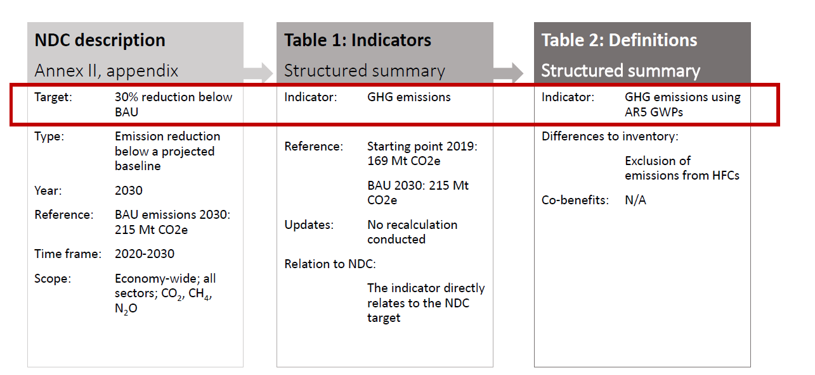
Linking CTF tables
Source: UNFCCC, CGE Training materials -Mitigation Assessment

Slide 7
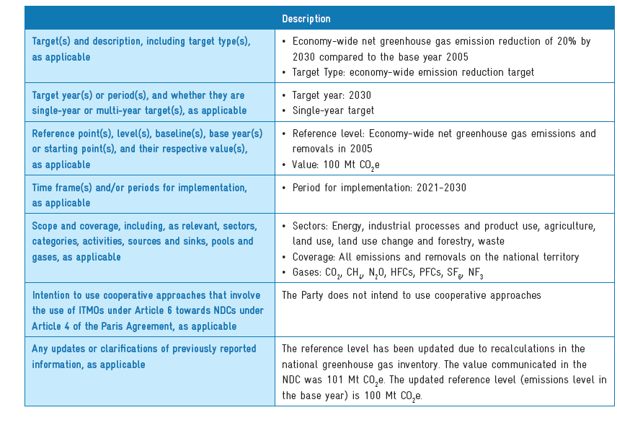
Example of a completed Appendix
Description of a Party’s NDC
Source: Partnership on Transparency in Paris Agreement, Accounting for National Determined Contributions

Slide 8
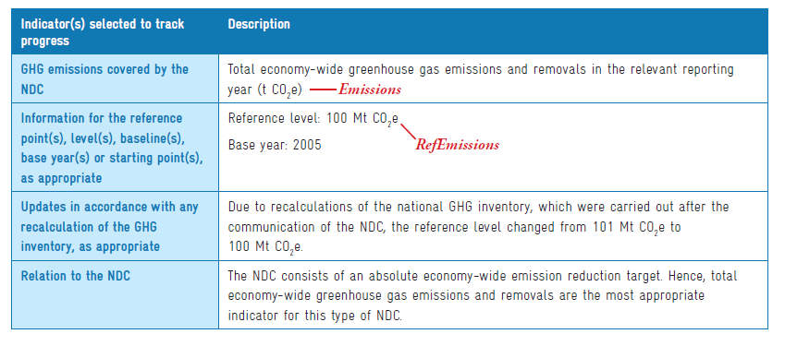
Example of a completed CTF table 1
Description of selected indicators
Source: Partnership on Transparency in Paris Agreement, Accounting for National Determined Contributions

Slide 9
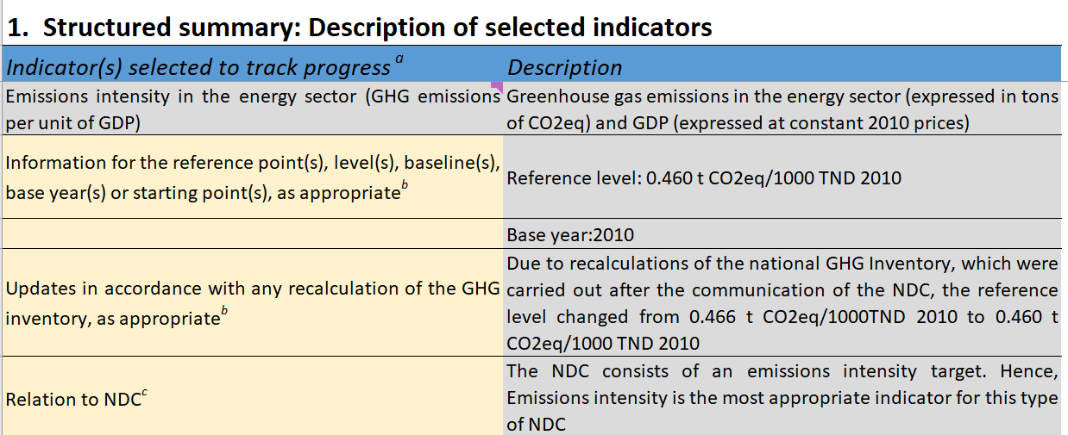
Example of the CTF Table 1 for Tunisia

Slide 10
Fill in CTF Tables 1, 2 with data for your country
Data for your country Table A “Tables to be filled by participants”
Fill in Tables CTF 1, CTF 2 in the file “CTF_Tracking_Progress_NDC_Template_Clean”
Examples of completed tables CTF_Tracking_Progress_NDC_Template_Tunisia Appendixes

Slide 11
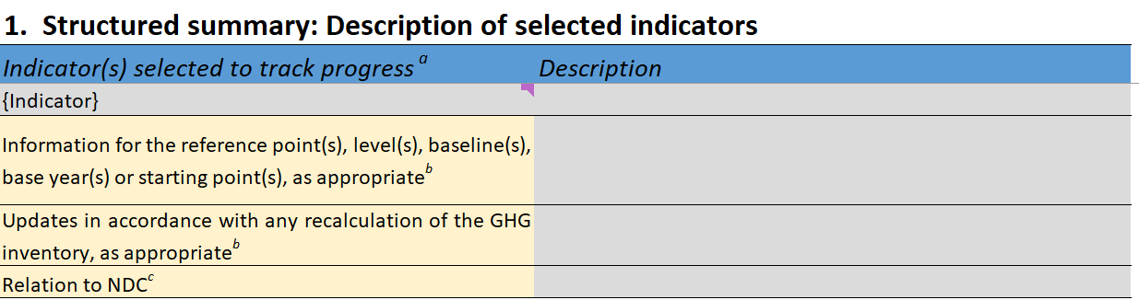
Table 1 CTF. Structured summary: Description of selected indicators
Complete the CTF Table 1 using data for your country

Slide 12
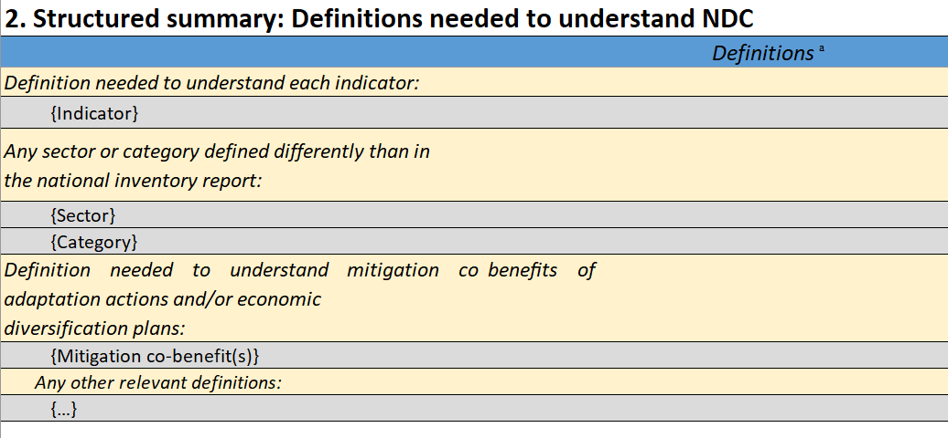
Table 2 CTF. Structured Summary: Definitions Needed to Understand NDC
Complete the CTF Table 2 using data for your country

