Slide 1








Tracking Progress of the Mitigation Commitments of Nationally Determined Contributions (NDCs)
Presentation: Supporting tools to develop economy wide GHG emissions projections: GACMO
Dr Aiymgul Kerimray
Mitigation specialist
UNEP Copenhagen Climate Centre

Slide 2
What is GACMO
Model GACMO = Greenhouse gas Abatement Cost Model
Bottom-up modelling tool for greenhouse gas emissions based on Excel
IPCC / CDM Methodologies
Developed by Jørgen Fenhann at UNEP CCC
Available for free on the UNEP CCC website GACMO tool - UNEP-CCC (unepccc.org)

Slide 3
GACMO is a simple tool
The tool should be able to make Business As Usual (BAU) projection to:2025/2030/2035/2050
GACMO can make a NDC with a reduction of a percentage reduction of the GHG emission compared to the BAU.
The tool should be able to calculate the GHG reduction and the cost for each mitigation option compared to the technology used in the baseline.
The tool should be able to scale the size of the mitigations option up and down.
The tool should give a clear overview of the total mitigation effort: total GHG reduction, total investment, and total annual cost.
The calculation should be transparent and easy to follow.

Slide 4
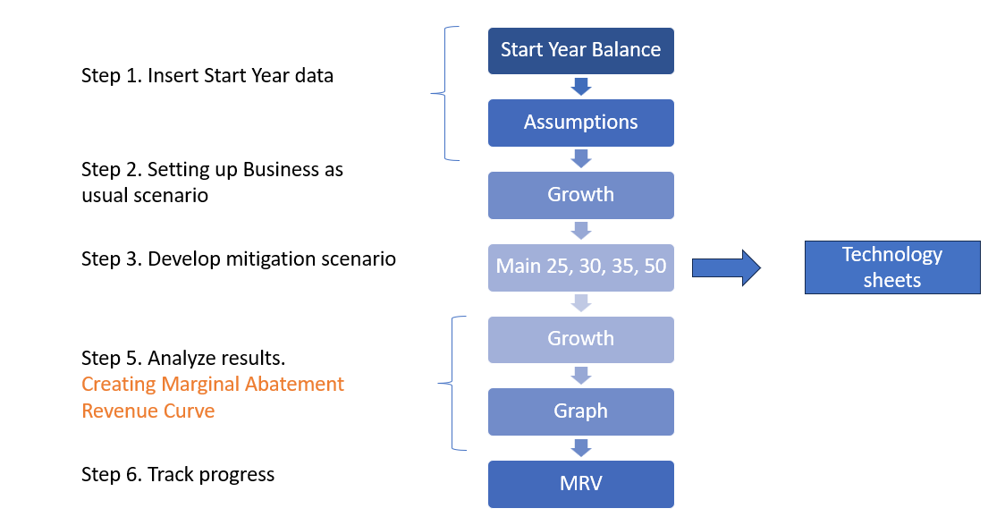
Steps to develop GACMO model

Slide 5
BAU scenario
Total GHG emissions
CO2 emissions from fuel combustion
Non-CO2 emissions from energy sector
GHG emissions in BAU scenario
GHG emissions from non-energy sectors

Slide 6
Input data for GACMO
GHG emissions inventory by sectors
(latest available year).
Energy Balance
(same year as GHG emissions inventory year).
Emission factors
(if national emission factors are available).
Growth rates of energy consumption by sectors
(annual % change up to 2025, 2030, 2035 and 2050).
Mitigation actions by 2025, 2030, 2035, 2050.
Technical and economical parameters of the technology/mitigation options (new technology and baseline technology).
Key assumptions
(e.g. grid emission factor, energy prices, etc.).

Slide 7
Mitigation options in GACMO
There are 119 pre-defined mitigation options available in GACMO
The user can select and adjust mitigation option applicable for the country

Slide 8
Approach for the calculation of emission reduction for a mitigation option
Example of efficient lighting
LED lamps replacing incandescent light bulbs
Emissions in reference option (incandescent light bulbs)
Emissions in reduction option (LED lamps)
Emission reduction from mitigation measure

Slide 9
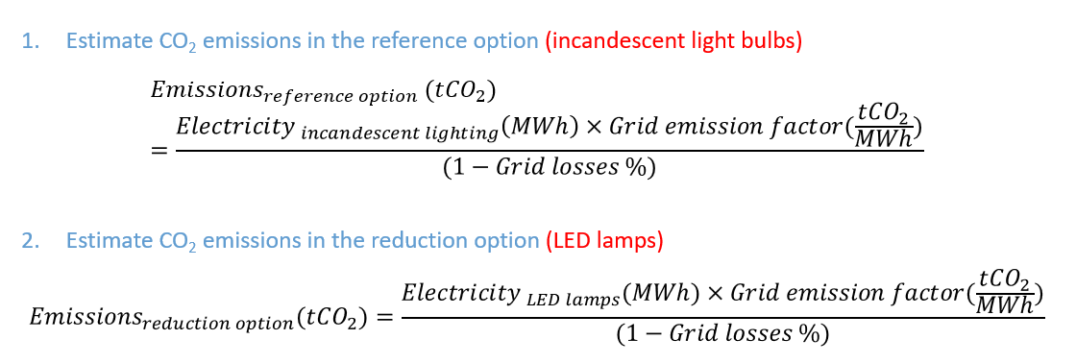
Approach for the calculation of emission reduction for a mitigation option

Slide 10
GACMO summary table for the 22 GHG mitigation options in the Maldives

Slide 11
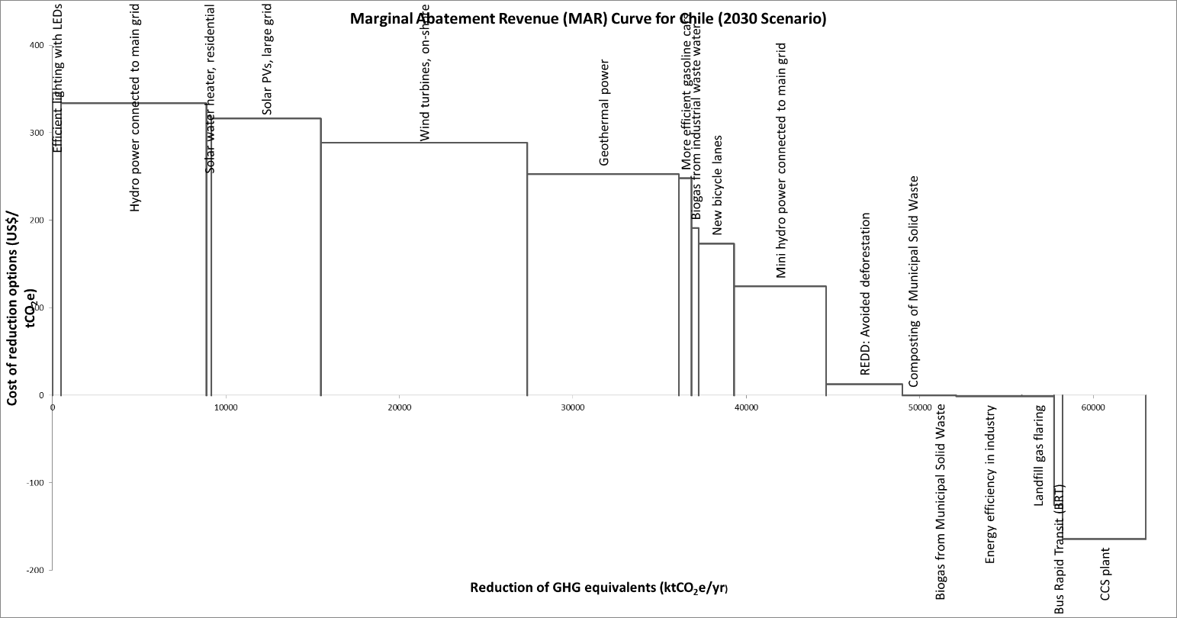
Results of GACMO
Marginal Abatement Revenue (MAR) curve for Chile
Marginal Abatement Cost Curve (MACC) or Marginal Abatement Revenue Curve (MARC) can be created.
A MACC/MARC presents the costs or savings of the mitigation actions and expected emissions reductions from those mitigation actions.
MACC/MARC can be useful tool to select mitigation actions appropriate for the country based on the emissions reductions and costs/revenues.

Slide 12
Mitigation options included/excluded in the MAR curve for Chile

Slide 13
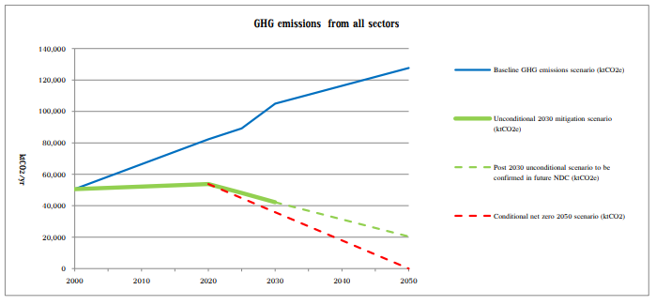
Results of GACMO:
GHG emissions projections in BAU and Mitigation scenario
Example of use of GACMO for NDC for Lao PDR

Slide 14
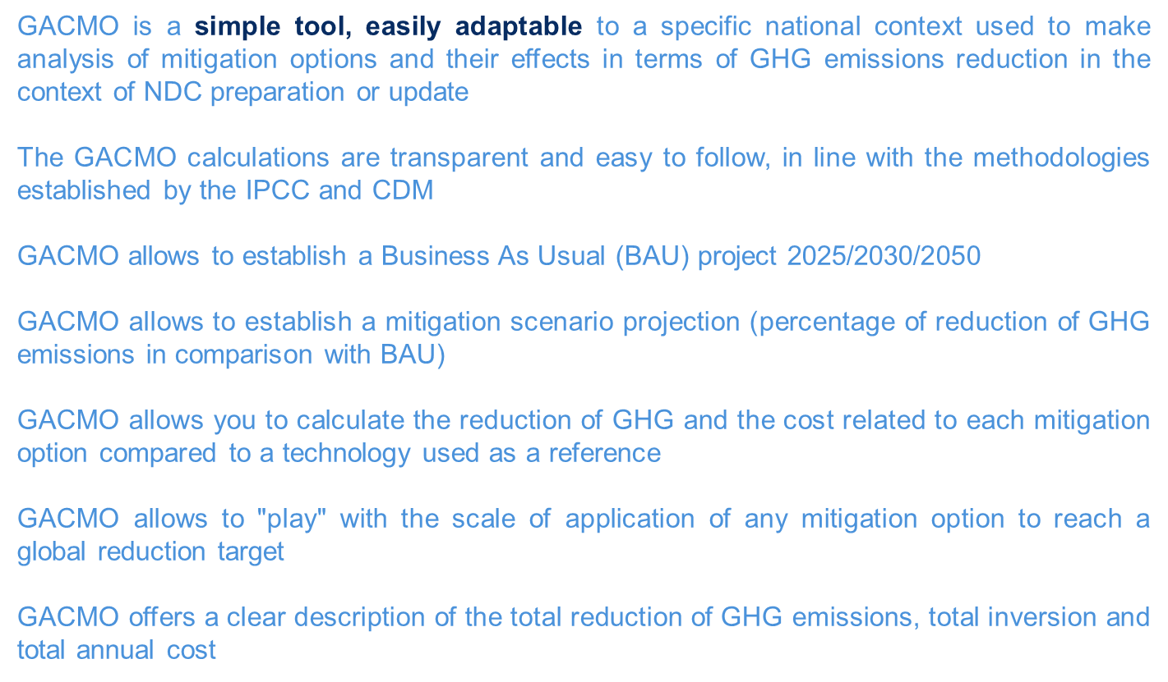
Conclusion

Slide 15
Thank you!
Aiymgul Kerimray – aiymgul.kerimray@un.org

